Slide 1
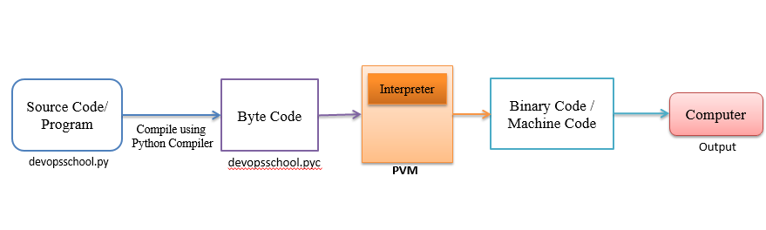
Python Virtual Machine
Python Virtual Machine (PVM) is a program which provides programming environment.
The role of PVM is to convert the byte code instructions into machine code so the computer can execute those machine code instructions and display the output. Interpreter converts the byte code into machine code and sends that machine code to the computer processor for execution.

Slide 2
Features in Python
1. Easy to code: Python is a high-level programming language. Python is very easy to learn the language as compared to other languages like C, C#, Javascript, Java, etc. It is very easy to code in python language and anybody can learn python basics in a few hours or days. It is also a developer-friendly language.
2. Free and Open Source: Python language is freely available at the official website and you can download it from the given download link below click on the Download Python keyword. Download Python Since it is open-source, this means that source code is also available to the public. So you can download it as, use it as well as share it.
3. Object-Oriented Language: One of the key features of python is Object-Oriented programming. Python supports object-oriented language and concepts of classes, objects encapsulation, etc.
4. GUI Programming Support: Graphical User interfaces can be made using a module such as PyQt5, PyQt4, wxPython, or Tk in python. PyQt5 is the most popular option for creating graphical apps with Python.
5. High-Level Language: Python is a high-level language. When we write programs in python, we do not need to remember the system architecture, nor do we need to manage the memory.
6. Extensible feature: Python is a Extensible language. We can write us some Python code into C or C++ language and also we can compile that code in C/C++ language.

Slide 3
7. Python is Portable language: Python language is also a portable language. For example, if we have python code for windows and if we want to run this code on other platforms such as Linux, Unix, and Mac then we do not need to change it, we can run this code on any platform.
8. Python is Integrated language: Python is also an Integrated language because we can easily integrated python with other languages like c, c++, etc.
9. Interpreted Language: Python is an Interpreted Language because Python code is executed line by line at a time. like other languages C, C++, Java, etc. there is no need to compile python code this makes it easier to debug our code. The source code of python is converted into an immediate form called bytecode.
10. Large Standard Library Python has a large standard library which provides a rich set of module and functions so you do not have to write your own code for every single thing. There are many libraries present in python for such as regular expressions, unit-testing, web browsers, etc.
11. Dynamically Typed Language: Python is a dynamically-typed language. That means the type (for example- int, double, long, etc.) for a variable is decided at run time not in advance because of this feature we don’t need to specify the type of variable.

Slide 4
Python OOPs Concepts
In Python, object-oriented Programming (OOPs) is a programming paradigm that uses objects and classes in programming. It aims to implement real-world entities like inheritance, polymorphisms, encapsulation, etc. in the programming.
The main concept of OOPs is to bind the data and the functions that work on that together as a single unit so that no other part of the code can access this data.

Slide 5
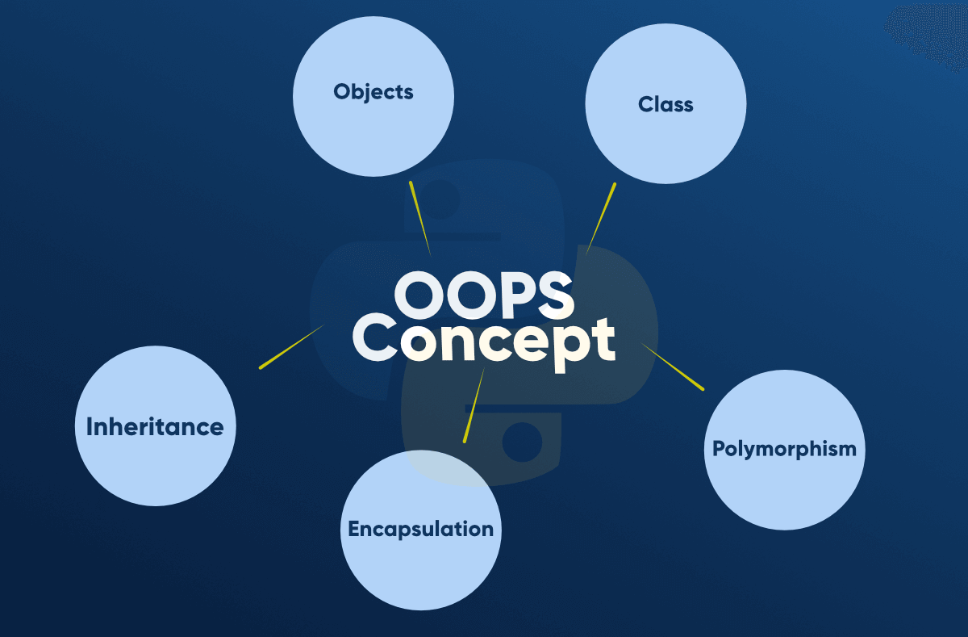

Slide 6
Class
A class is a collection of objects. A class contains the blueprints or the prototype from which the objects are being created. It is a logical entity that contains some attributes and methods.
To understand the need for creating a class let’s consider an example, let’s say you wanted to track the number of dogs that may have different attributes like breed, age.
If a list is used, the first element could be the dog’s breed while the second element could represent its age.
Let’s suppose there are 100 different dogs, then how would you know which element is supposed to be which? What if you wanted to add other properties to these dogs? This lacks organization and it’s the exact need for classes.

Slide 7
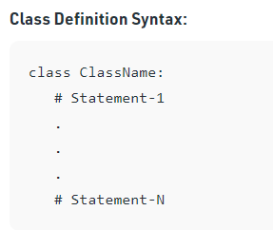

Slide 8
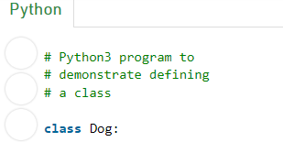

Slide 9
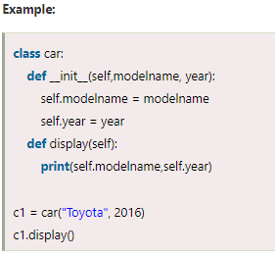
Object
The object is an entity that has state and behavior. It may be any real-world object like the mouse, keyboard, chair, table, pen, etc.
When we define a class, it needs to create an object to allocate the memory. Consider the following example.
In the above example, we have created the class named car, and it has two attributes modelname and year. We have created a c1 object to access the class attribute. The c1 object will allocate memory for these values.

Slide 10
Inheritance
Inheritance is the most important aspect of object-oriented programming, which simulates the real-world concept of inheritance. It specifies that the child object acquires all the properties and behaviors of the parent object.
By using inheritance, we can create a class which uses all the properties and behavior of another class. The new class is known as a derived class or child class, and the one whose properties are acquired is known as a base class or parent class.
It provides the re-usability of the code.

Slide 11
Polymorphism
Polymorphism contains two words "poly" and "morphs". Poly means many, and morph means shape. By polymorphism, we understand that one task can be performed in different ways.
For example - you have a class animal, and all animals speak. But they speak differently. Here, the "speak" behavior is polymorphic in a sense and depends on the animal.
So, the abstract "animal" concept does not actually "speak", but specific animals (like dogs and cats) have a concrete implementation of the action "speak".

Slide 12
Encapsulation
Encapsulation is also an essential aspect of object-oriented programming. It is used to restrict access to methods and variables. In encapsulation, code and data are wrapped together within a single unit from being modified by accident.
Data Abstraction
Data abstraction and encapsulation both are often used as synonyms. Both are nearly synonyms because data abstraction is achieved through encapsulation.
Abstraction is used to hide internal details and show only functionalities. Abstracting something means to give names to things so that the name captures the core of what a function or a whole program does.

